Slide 1







UNIFIED
DINING
( Revolutionizing the Online Food Ordering Experience )

Slide 2





Contents
01
02
03
Problem
Solution
Objective &
scope
04
05
06
Project
Roadmap
Conclusion
Team

Slide 3

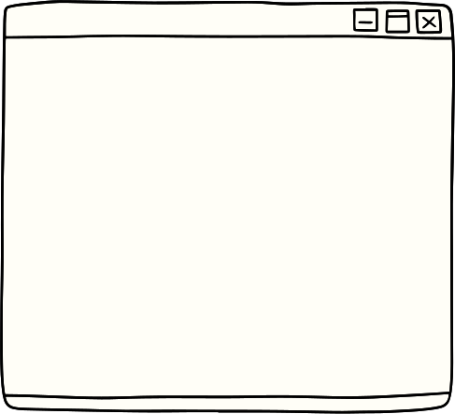


Problem
The identified problem is the diversity and complexity of user interfaces across different online dining applications. This issue can be particularly challenging for certain demographics, notably the elderly.

Slide 4
Solution
Uniformity in User Interfaces
User-Friendly Mobile Experience
Single Login for Multiple Services

Slide 5

Objective and Scopes
Introduce Standard Layout: Revolutionize dining applications with a standard layout.
Simplify User Interfaces: Make interactions efficient by addressing varied and complex interfaces.
Unified Interface for Elderly: Simplify mobile interactions with a unified interface, especially for the elderly.
Full-Featured Apps: Extend to creating full-featured Android and iOS apps.
Centralized Account Service: Provide a single login for all dining access.
Major Brands Integration: Plan to integrate major brands into our web-app.
Valuable Learning Experience: Provides a learning experience from building to deploying a product.

Slide 6





Project
Idea
PROJECT ROADMAP
01
:Assemble the team and lay the foundation for the project. Establish goals, determine the scope, and generate ideas. t. Quisque facilisis tincidunt risus sit amet sagittis. Praesent tempus vitae felis maximus pretium.
Interface
design
02
: Concentrate on designing a uniform user interface for dining applications. Create comprehensive design prototypes to maintain consistency across different platforms
Prototype
creation
03
Start the construction of the interactive web-app prototype utilizing technologies like Next.js, Prisma, Supabase etc. Conduct regular meetings and reviews to ensure the project stays on track.
04
Perform thorough testing of the application to detect and rectify any bugs or issues. Gather user feedback to make necessary adjustments for enhancing usability and functionality.
Testing
& bugs
fixes
05
Get ready for the official launch by focusing on deploying the app to the respective platforms. Formulate marketing strategies to mark the commencement of public access.
Deployment

Slide 7
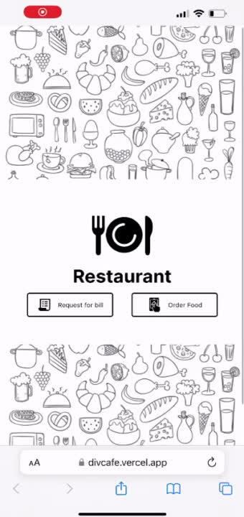

Slide 8






Conclusions
Project Impact:
Future Innovations
Learning and Development
Our interactive web-app revolutionizes the dining application landscape by introducing a standard layout across different platforms. This simplifies the user experience, particularly for the elderly, and has the potential to significantly change the online dining landscape.
We plan to extend our services by creating full-featured Android and iOS apps, a centralized account management service, and integrating major dining brands. This will provide users with a single login for all their dining needs, further simplifying the online dining experience.
This project has provided us with valuable experience in building and innovating a product from its initial stage to its final deployment phase. We’ve learned and applied various technologies, which has improved our understanding of various areas of study. This revolutionary idea is particularly relevant in the post-pandemic world where online dining has become increasingly prevalent.

Slide 9
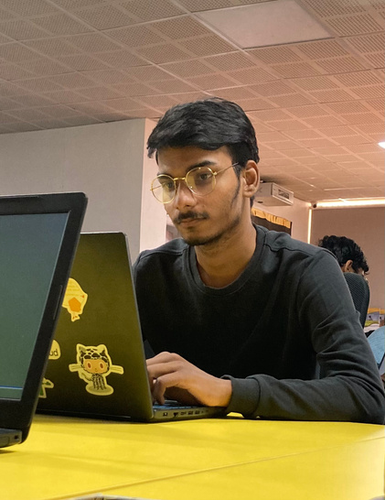

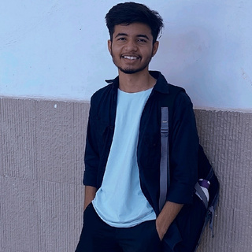
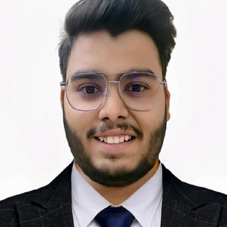

The team
Divyanshu Lohar
Burhanuddin
Ajaypal Singh Chundawat
Siddharth Bansal
Pratham Pitliya
Team lead
(20ETCCS037)
(20ETCCS019)
(20ETCCS004)
(20ETCCS089)
(20ETCCS102)

Slide 10


Thank you
Presented by :
TECH TRANSFORMERS

